Slide 1
Lecture-7
Basic Statistics and Hypothesis Testing
Md. Fazlul Karim Patwary
Professor
Institute of Information Technology Jahangirnagar University

Slide 2
Basic Statistics
The most basic statistical analysis are the measure of central tendency and the measure of dispersion
Measure of central tendency
Median: The middle number in a set of data
Mode: The number within the set of data that appears the most frequently
Statistical Mean: i.e. the average
Measure of dispersion
Statistical Variance: Determined by averaging the squared difference of all the values from the mean
(remember the n-1 in the denominator~)

Slide 3


Statistical Inference
Two types of statistics
Descriptive statistics and inferential statistics
Statistical inference is a process of using observations of a sample to estimate the properties of the population
Descriptive statistics are obtained from the entire POPULATION
N population size
µ mean, expected value E[X]
var variance, Var(X)
Inferential statistics comprises the use of statistics to make inferences concerning some unknown aspect of a population

Slide 4
Statistical Inference
Are obtained from SAMPLES of a population
n sample size
X(n) statistical mean, sample mean, average
S²(n) sample variance
Have assumed that the sample reflects the population in an unbiased form (That is, the samples are chosen according to the distribution of the population) the statistics obtained under this assumption are regarded as “the unbiased estimators”

Slide 5
Statistical Inference
The results collected from general observations or surveys of a portion of the entire population correspond to inferential statistics
The results obtained from simulation runs also correspond to inferential statistics of the true situation
We have to specify the number of simulation runs we have performed
i.e. the number of samples (n) we have collected
The obtained values (e.g. average waiting time, average queue length) are estimations of the true values

Slide 6
Regression Analysis
Regression analysis examines the dependence of a random variable (the dependent variable) on other random or deterministic variables (the independent variables)
Independent variables: the known variables in a regression analysis
Dependent variables: the variables we are trying to predict in regression analysis
E.g. we want to find out the relationship between the interests in studying Queueing Theory and the student gender
Independent variable: gender of the student (male or female)
Dependent variable: the degree of interest
The gender of the student may affect the degree of interest of his/her studies. But the degree of interest cannot alter the fact of a student being a girl or a boy!

Slide 7
Regression Analysis
In regression analysis, we shall develop an estimating equation, that is, a mathematical formula that relates the known variables to the unknown variable
The estimation equation relates the two random variables X (independent variable) and Y (dependent variable)
A scatter diagram (introduced in next slide) is plot
For variables exhibiting relation with each other, an estimating line can be drawn
Equation of a linear estimating line: Y = aX + b

Slide 8
Scatter Diagrams
Scatter diagram is a graph for observing relationship between two variables
❐
E.g. we want to see if the performance in 2040 will affect that in 3050 (assume 2040 is a prerequisite for 3050, all 3050 students have already taken 2040)
❐
Let the performance be measured in terms of scores
We make the following scatter diagram
Y-axis: scores in 2040 (independent variable)
X-axis: scores in 3050 (dependent variable)
Each dot (X_{i}, Y_{i}) corresponds to the scores of student i

Slide 9
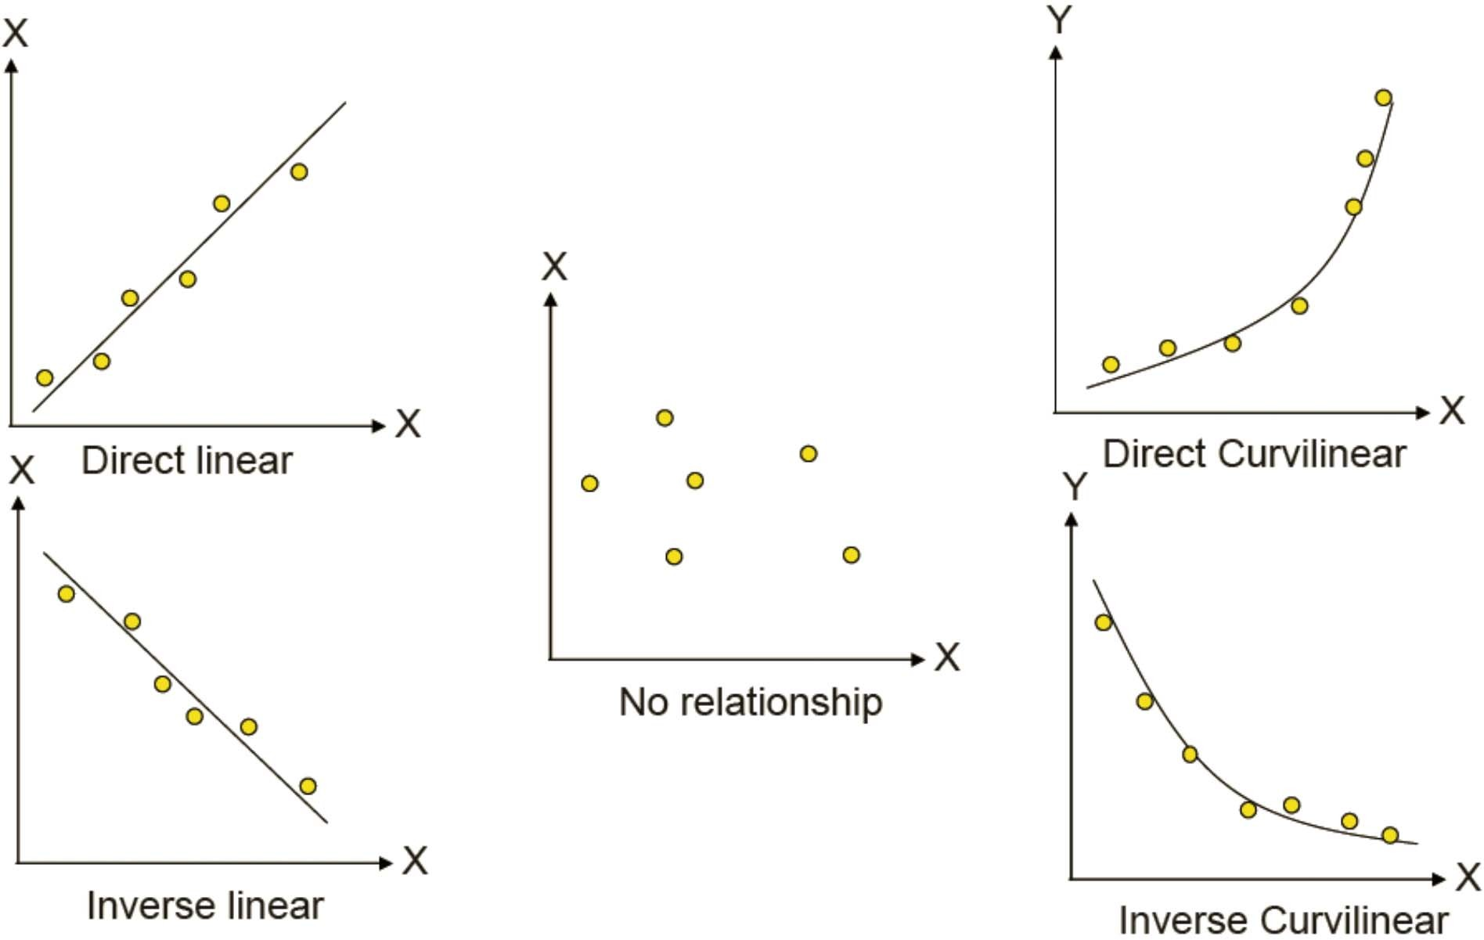
Scatter Diagrams

Slide 10
Correlation Analysis
After the pattern have been learnt, we can apply correlation analysis to determine the quantitative degree to which the variables are related
Correlation analysis is the statistical tool we can use to describe the degree to which one variable is linearly related to another
Often, correlation analysis is used in conjunction with regression analysis to measure how well the regression line explains the variation of the dependent variable
Correlation coefficients have been developed to describe the correlation between two variables

Slide 11
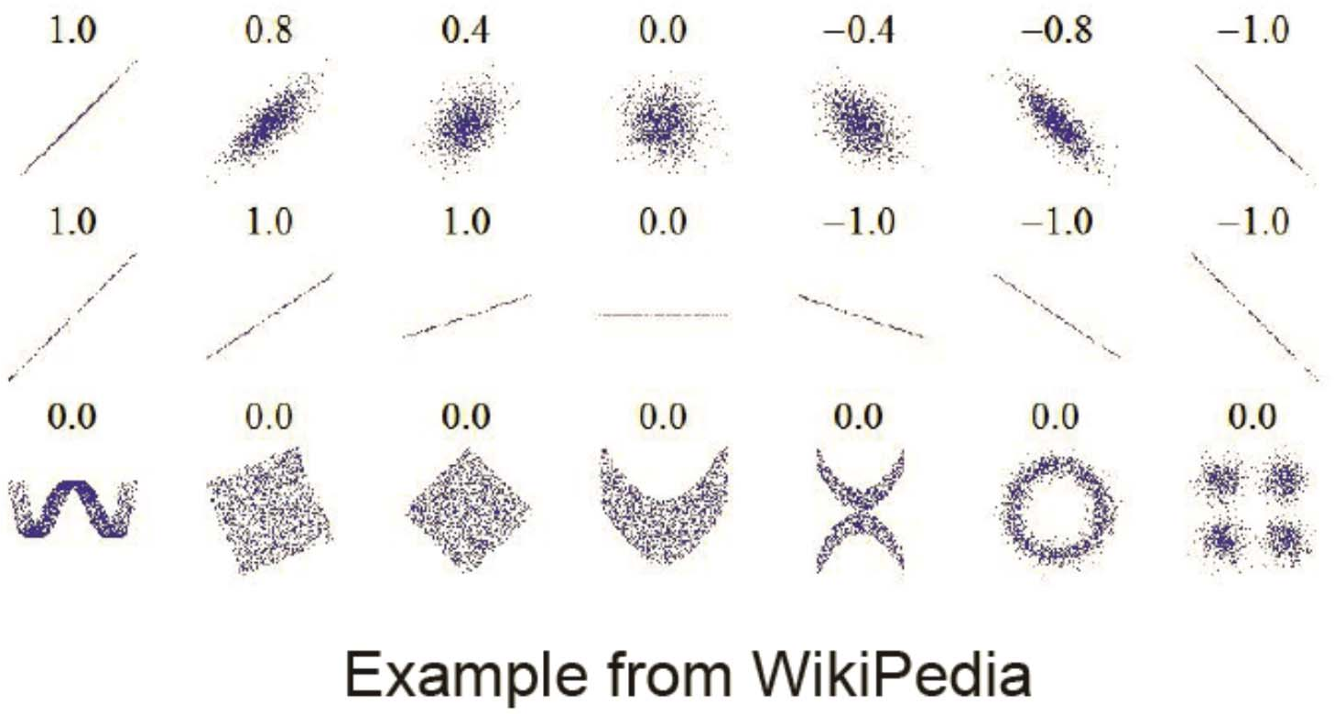
Correlation Analysis
Pearson Correlation Coefficient
It is a numerical index of the amount of association between two sets of variables. Ranges between -1 to 1
■ +value indicates a positive correlation, -value indicates a negative correlation

Slide 12
Significant Level
In statistics, a result is called significant if it is unlikely to have occurred by chance
"A statistically significant difference" means there is statistical evidence that there is a difference
For example, the purpose of hypothesis testing is to make a judgment about the difference between that sample statistic and a hypothesized population parameter
If we assume the hypothesis is correct, then the significance level will indicate the percentage of sample means that is outside certain limits
Significant level is a value which can be chosen before we perform the statistical analysis
The smaller the significance level we use, the more confident we can say about the analysis result

Slide 13
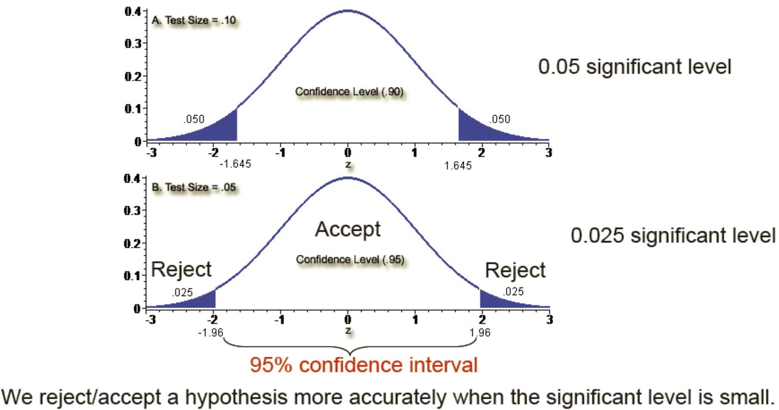
Significant Level
In general, statistical judgements are more accurate when the value of significant level is small

Slide 14
Normal Distribution
Normal distribution is a very important continuous distribution
It come close to fitting the distribution of many normal phenomena, such as weight, height, IQ
The curve of a normal distribution is bell shape. It has the following properties
The mean of the normally distributed population lies at the center of its normal curve
Symmetry
The percentage of values lies under the left / right of critical points of the curve is well defined. We have the 68-95.5-99.7-percent rule
~68% of all the values in a normally distributed population lies within +/- 1 S.D. from the mean
~95.5% of all the values in a normally distributed population lies within +/- 2 S.D. from the mean
~99.7% of all the values in a normally distributed population lies within +/- 3 S.D from the mean
We can always look up the value that lies at a particular point of the curve and its corresponding number of S.D. from the mean from the Normal Distribution Table

Slide 15
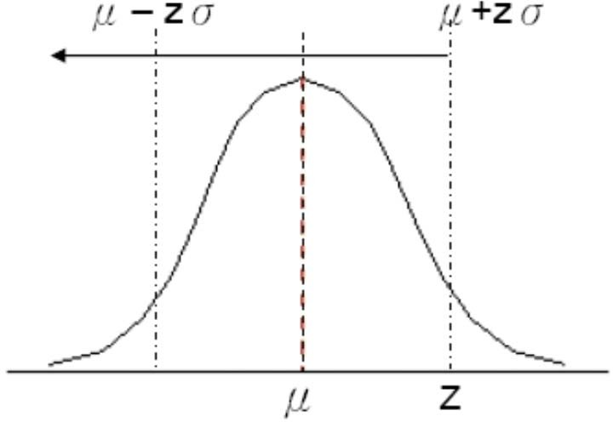
Normal Distribution
Let it’s mean and S.D. be μ and σ respectively
We can then check out the z value from the standard normal distribution
z = the number of σ deviated from the mean

Slide 16
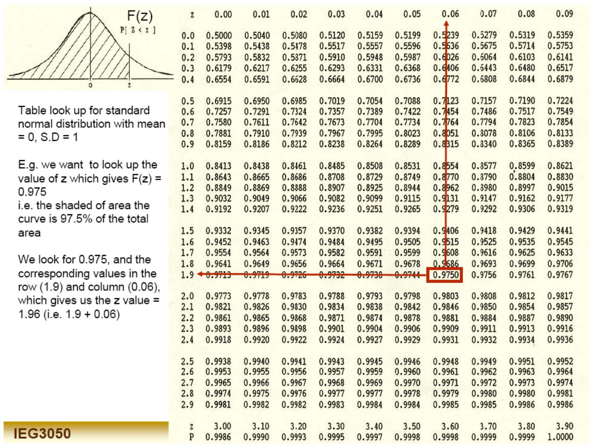
Normal Distribution

Slide 17
The Central Limit Theorem
The Central Limit Theorem (CLT) states that:
The sum of IID variables will be approximately normally distributed
This implies the sampling distribution of the mean approaches normal as the sample size increases, regardless the distribution of the original population. The sampling mean will approach the population mean
Sample mean = sum of the sample / sample size

Slide 18
The Law of large Numbers
The Law of Large Numbers (LLN) is states that:
Let X₁, X₂, … be IID random variables with mean μ and variance σ², X(n) be the average of n samples of them
Then the limit of probability of (|X(n) - μ|≧ε) when n → ∞ is 0
Epsilon (ε) is an arbitrary positive constant
In other words, the LLN states that the sampling mean equals the mean when the sample size is infinitely large
That is X(n) = μ when n → ∞

Slide 19
Sampling Distribution
A sampling distribution is the probability distribution of all means obtained from sampling
E.g. For a population of 20,000 CUHK students, we want to find out the mean of the students’ GPA
Suppose the mean (the true answer) is μ, variance is σ²
We then sample 100 students, and obtain an average GPA, ^{μ}x1
We repeat the sampling for many times (say, 10000 times, but can be infinitely), each time we randomly select 100 students and calculate their average
Lastly, we plot the frequency graph for these averages ^{{μ}_{x1}^{, μ}_{x2}^{, … μ}_{x10000}}
The graph of μ_{x} will have a normal distribution with mean μ and S.D. ≈ σ/ n

Slide 20
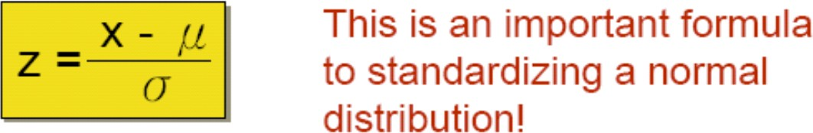
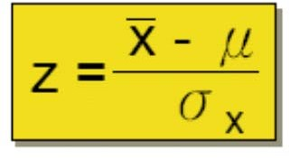
Sampling Distribution
The S.D. of the distribution of the sample is called the standard error of the mean (σ_{x})
We thus have σ_{x}= σ/n
where σ = population standard deviation, n = sample size
For a normal distribution X with mean μ and S.D. σ, the variable Z ~ standard normal distribution where
Therefore, the z value (i.e. the one for table look up) has the following relationship with the population mean μ and standard error of the mean σ_{x}

Slide 21
Hypothesis Testing
An example: A professor wants to find out students’ monthly income during summer vacation. Past year figures shows that the mean and variance are $8000 and $400 respectively. The professor thus hypothesizes the mean as $8000, and $400 respectively.
After the vacation, the professor wants to verify if his hypothesis is correct, and adopts a significance level (α) of 0.05 in testing. He selects 100 students from population, and record down their salary. The sample mean among these 100 students is $7,800.

Slide 22
Hypothesis Testing
Here, the null hypothesis, alternative hypothesis, and significance level, hypothesized mean, as well as the descriptive statistics (sample variance, sample size, sample mean) are respectively:
H₀: μ = 8000
H₁: μ ≠ 8000
α= 0.05
μ_{H0} = 8000
σ = 400
n = 100
x = 7800

Slide 23
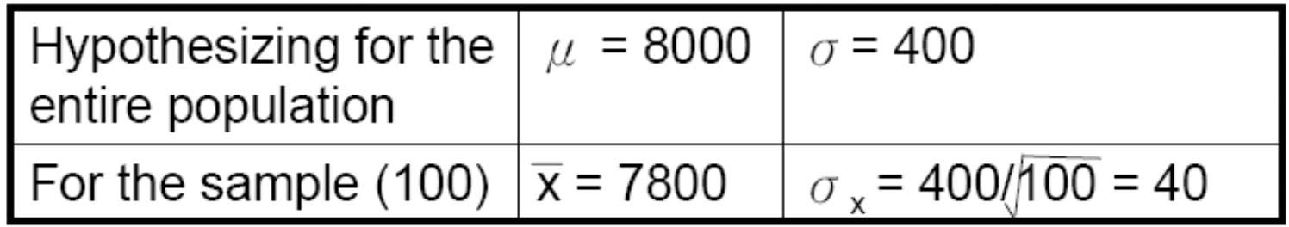
Hypothesis Testing
Idea: we are going to see if this is reasonable to observe a sample (= 7800) if the population mean is actually 8000 with variance of 400.
Firstly, we will compute the standard error of the mean (σ_{x}), which is defined as the standard deviation of the distribution of sample means
Here we have:

Slide 24
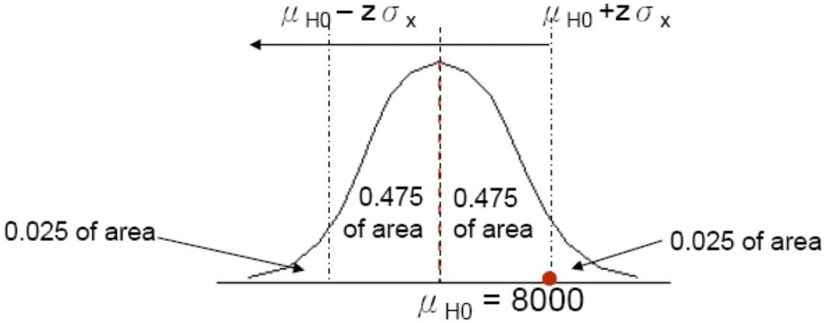
Hypothesis Testing : Table Look Up
α= 0.05 in two-tailed case correspond to the confidence level = 0.95. Since our population size is quite large, the hypothesized mean will have a normal distribution (note: for sample size smaller than 30, it has a t-distribution)
From the figure illustrated above, we are looking for a z which gives 0.975 of area under the left part of the curve
We look up the normal distribution table, and see that the corresponding z is 1.96 (refer to previous table)

Slide 25
Hypothesis Testing
A z value of 1.96 will gives the following upper bound and lower bound for the acceptance region
μ_{H0} +z σ_{x} = 8000 + 1.96(40) = 8078.4
μ_{H0} -z σ_{x} = 8000 - 1.96(40) = 7921.6
Therefore, we regard the hypothesis is correct (i.e., we accept the hypothesis) only when the sample mean fall into the range between 8078.4 and 7921.6
Since the sample mean in our case is 7800, therefore, we reject the hypothesis
What is the probability that we reject the hypothesis, but actually the hypothesis is true?
Given that the hypothesis is true, this equals the probability that we reject the hypothesis, which equal to the chance the sample mean falls beyond the acceptance region, this prob. = α

Slide 26
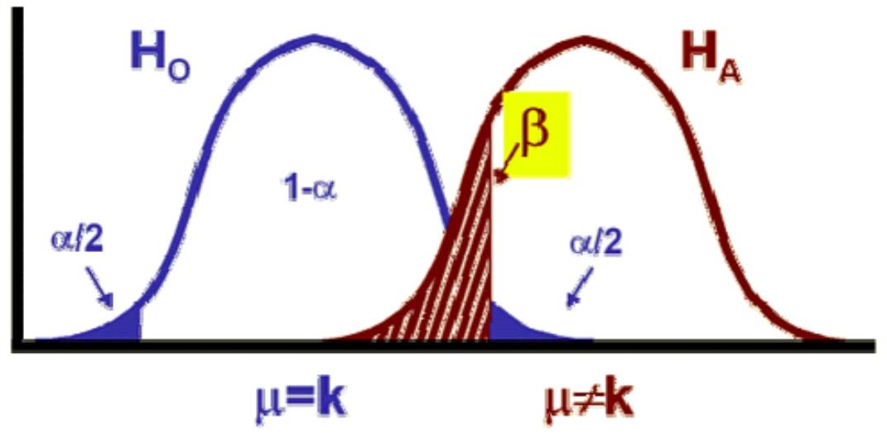
Hypothesis Testing
We have the Type I and Type II error for hypothesis testing
Type I error: rejecting a null hypothesis when it is true
Probability is α
Type II error: accepting a null hypothesis when it is false
Probability is β

Slide 27
Two-Tailed and One-Tailed Tests of Hypotheses
A two-tailed test of a hypothesis will reject the null hypothesis if the sample mean is significantly higher than or lower than the hypothesized population mean
E.g. H₀: μ = μ_{H0}, H₁: μ≠ μ_{H0}
There are two rejected regions
A one-tailed test is appropriate when we are only interested in whether the sample mean is significantly greater than the hypothesized mean right-tailed test. E.g. H₀: μ = μ_{H0}, H₁: μ >μ_{H0}
Or we are only interested in whether the sample mean is significantly smaller than the hypothesized mean left-tailed test. E.g. H₀: μ = μ_{H0}, H₁: μ <μ_{H0}

Slide 28
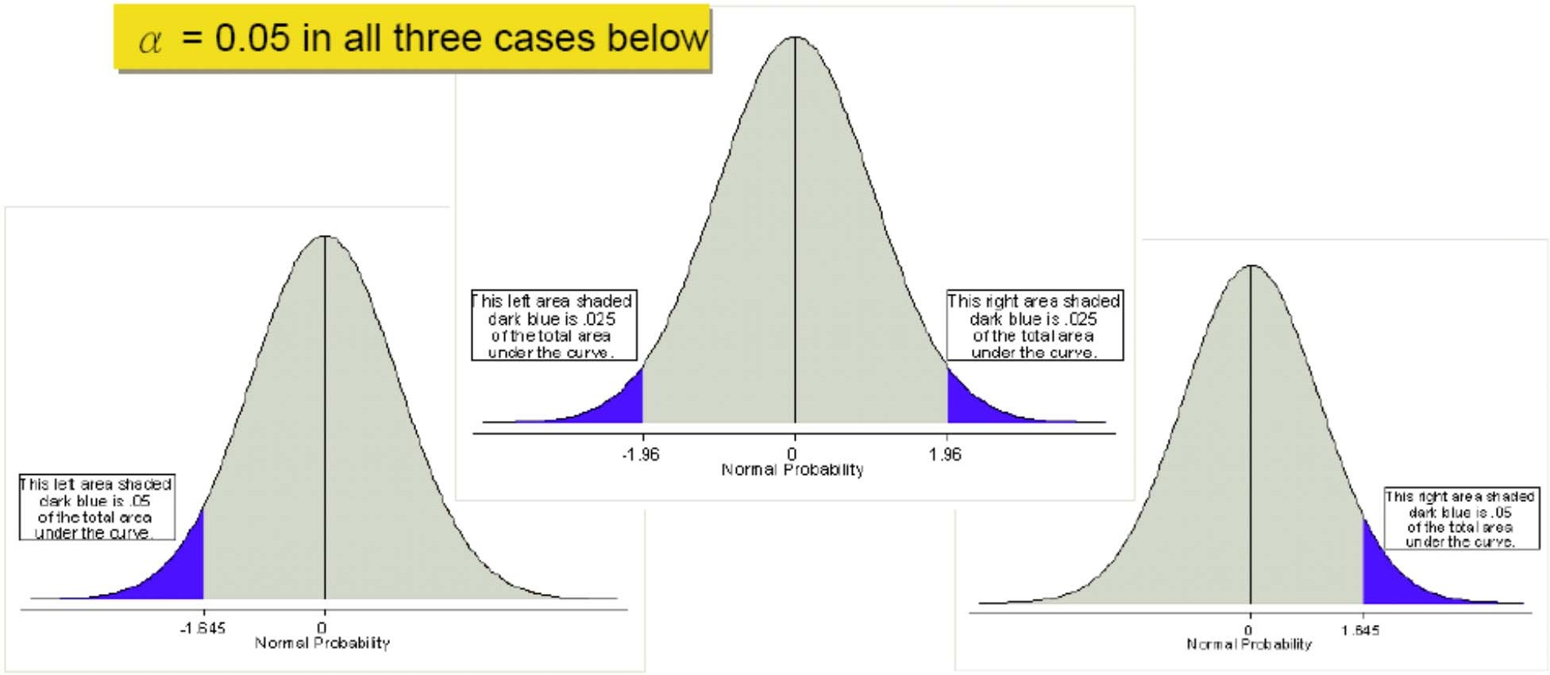
Two-Tailed and One-Tailed Tests of Hypotheses
The definition of significant level (α) is the same in both two-tailed and one-tailed cases, which corresponds to the area that the null hypothesis should be rejected

